Slide 1
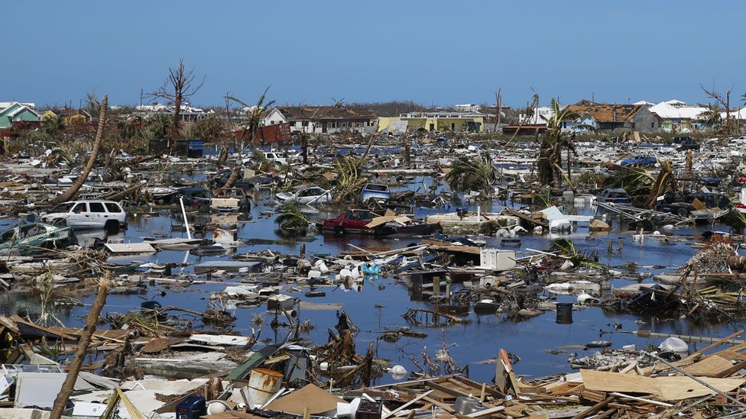
Classification of Buildings Post Hurricane
TEAM OUTLIERS:
Nanda Krishna
Prayash Panda
Rajat Gaur
Shishir Tripathi

Slide 2
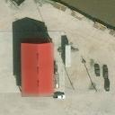
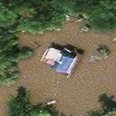
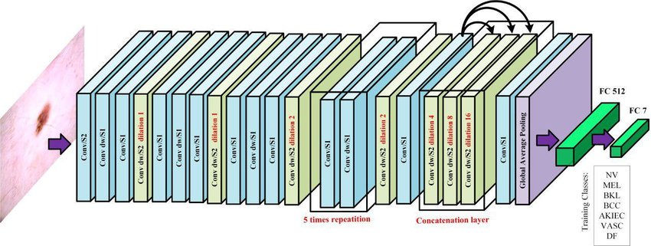
Introduction
Problem Statement and Dataset:
Approaches :
The Hurricane Dataset contains the satellite images of houses in a specific region post hurricane. This project aims to determine whether a certain building in the image is damaged or not. It contains images of following classes:
In this project we created two models; one was our own curated CNN model and another being the pre-trained Transfer Learning model based on MobileNetV2.
No Damage
Damage

Slide 3
Code & Packages Used:
Testing and evaluation of models using metrics and classification report
Visualizing data in easily interpretable plots.
Sklearn
Matplotlib
Using keras API for building Sequential CNN models.
Tensorflow
For visualising Grad-CAM heatmaps with useful colormaps
OpenCV
Visualising dataset in tabular form
Manipulating data-frames
Pandas
Making Visualisations for the CNN such as Grad-CAM
tf-keras-vis
Faster computation
Numpy
Notes:
The Various tools and platforms used were:
For Frontend: HTML5 for the web page, CSS3 for designing , Javascript for adding functionalities
For Backend: Django framework was used.
For Model generation and training python and google colab was used on cloud and jupyter-notebook was used for locally.

Slide 4
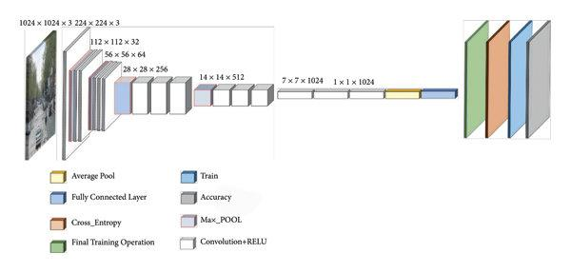
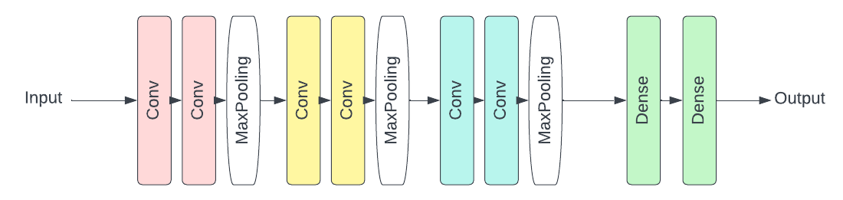
Methodology
Customized CNN :
Pre-trained MobileNetV2 :

Slide 5
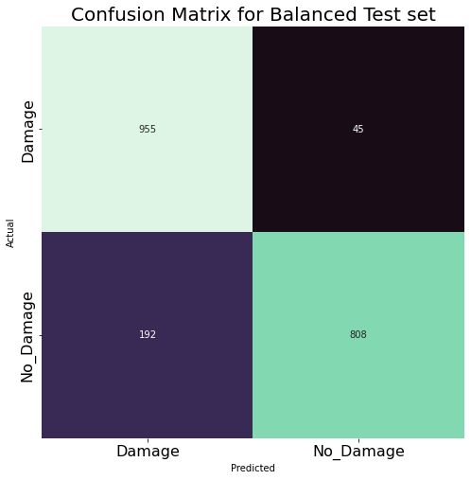
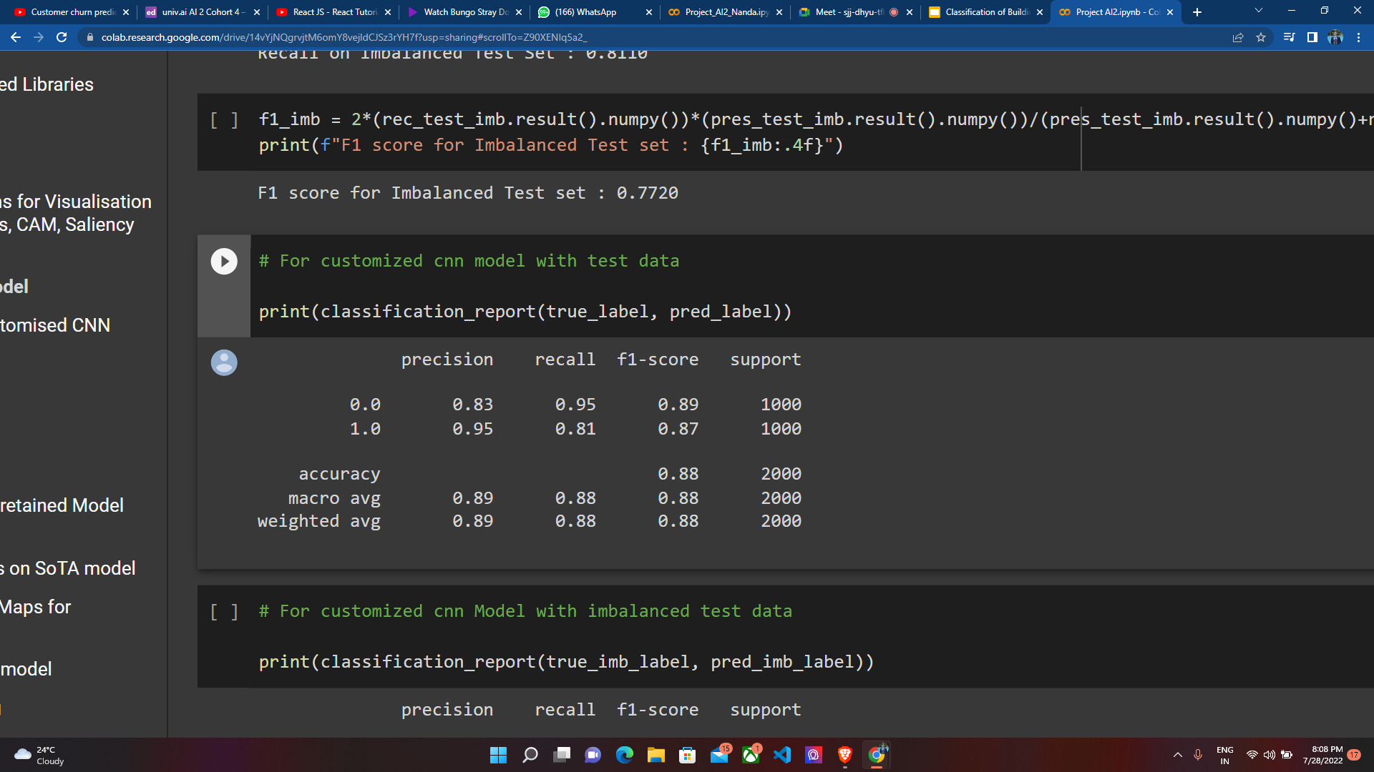
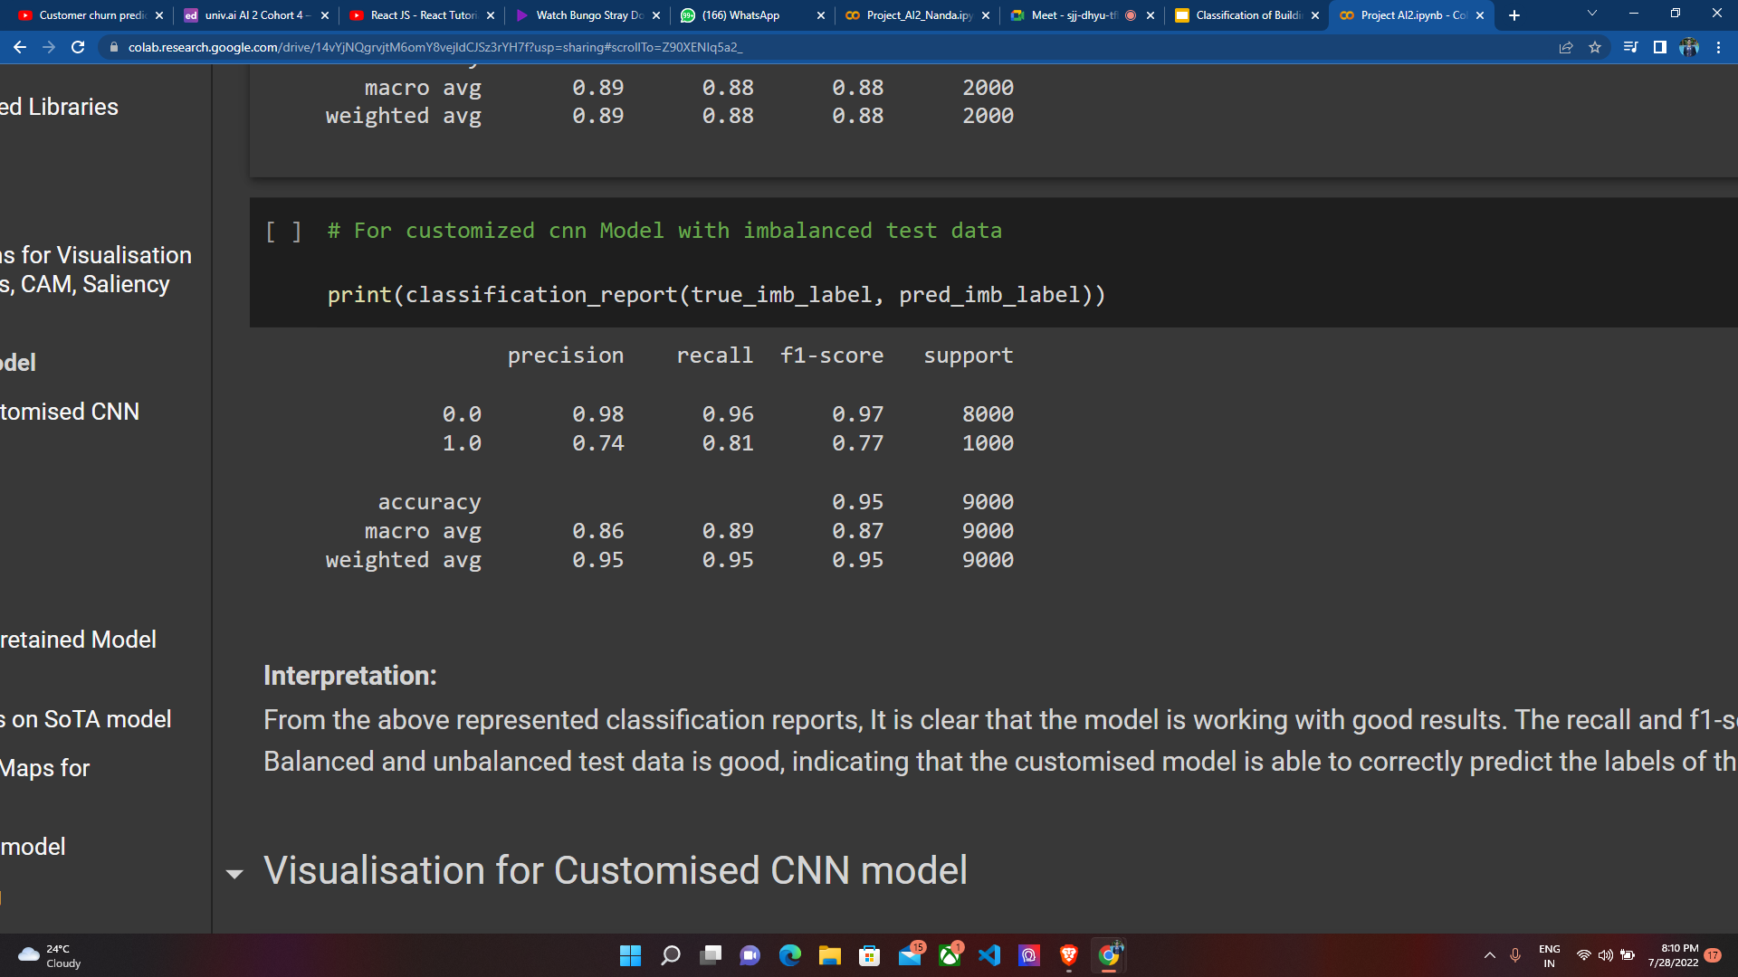
Customized CNN Model Results
Classification Report for Balanced Test Set:
Classification Report for Imbalanced Test Set:

Slide 6
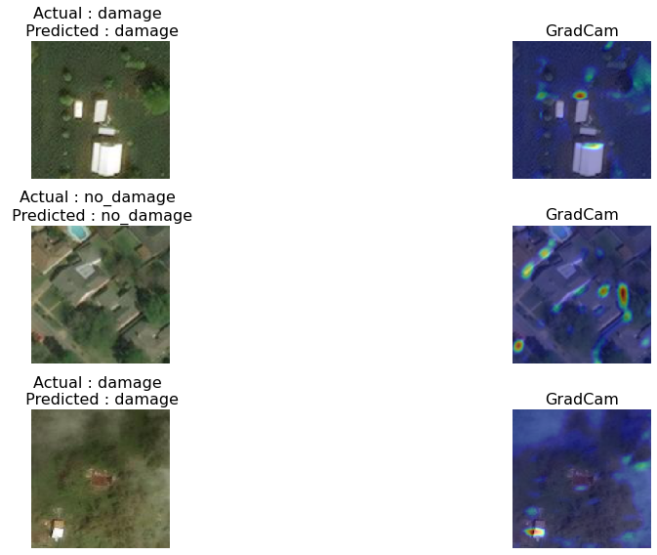
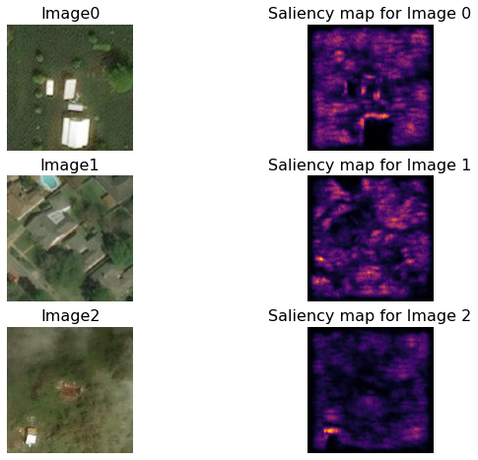
Visualisation for Customised CNN Model
Grad-CAM
Saliency Maps

Slide 7
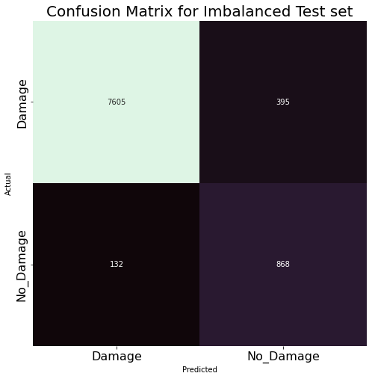
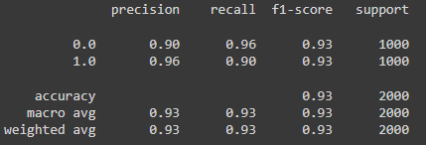
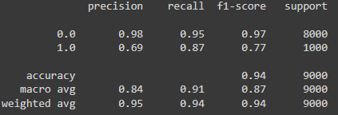
Pre-Trained MobileNetV2 Model
Classification Report for Balanced Test Set:
Classification Report for Imbalanced Test Set:

Slide 8
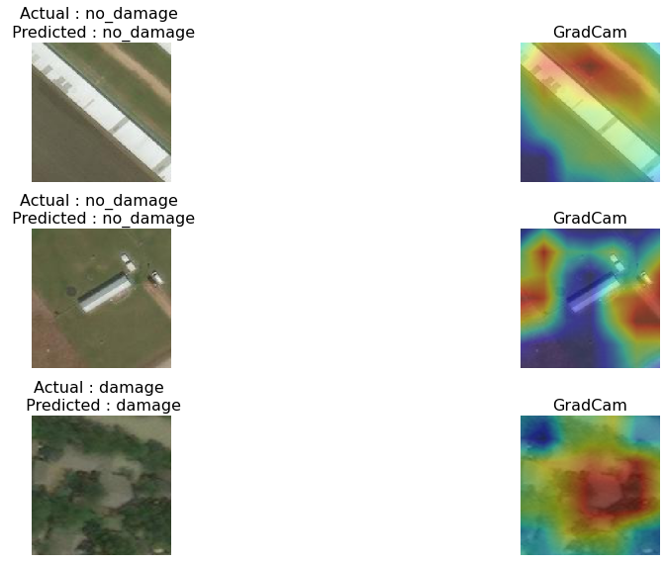
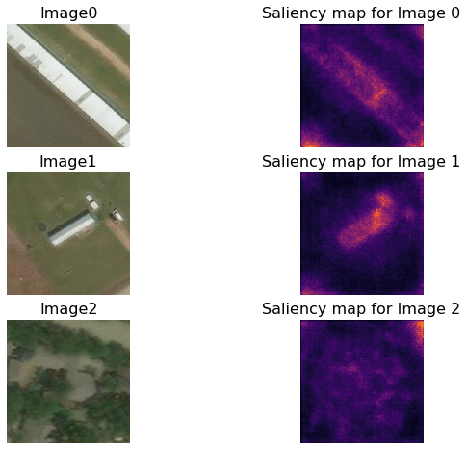
Visualisation for Pre-trained model
GradCAM
Saliency Maps

Slide 9
Conclusion
Our findings suggest us that using the transfer learning approach, the SoTA model - MobilenetV2 has outperformed the customised CNN model for the classification of buildings in terms of accuracy, recall and overall f1-scores.
The visualizations done with the help of saliency maps have suggested that the SoTA model could capture more important features in the classification task.
With regards to the task in hand, the MobileNetV2 based model does a significantly better job of classifying damaged houses on both test datasets. Most importantly, it shows great recall score for the imbalanced class (Not Damaged), which prioritises the correct detection of such houses in-order to avoid unnecessary allocation of supplies in real world.

Slide 10
Future Scope of Work
From this project we can even make an improvement for getting to know the total loss for a specific area and if we have a dataset which consists of even lateral view of the houses then there can be much more accurate predictions.
Also, if we can extend the study by including the coordinates as well which can be extracted through some other location based dataset which can give us even more accurate predictions.
We can also develop a web API platform which will take in images from a user and classify it automatically - this part can be included as model deployment with the help of platforms such as Heroku and Flask.

Slide 11
References
Dataset description and background research: https://en.wikipedia.org/wiki/Hurricane_Iota
Keras functions and handling: https://www.tensorflow.org/api_docs/python/tf/keras
For the visualisation of the Class attribution map, we have taken reference from https://github.com/jacobgil/keras-cam/blob/master/cam.py
MobileV2 Net Transfer Learning Approach: https://colab.research.google.com/drive/1eyBBEbMSHn16DTrlkpmunztSRW64UKih?usp=sharing (University Course Project on Pneumonia Images Classification using chest x-rays)

